Slide 1
Object Oriented Programming Constructors and Destructor
CS(217) Object Oriented Programming
Abeeda Akram

Slide 2
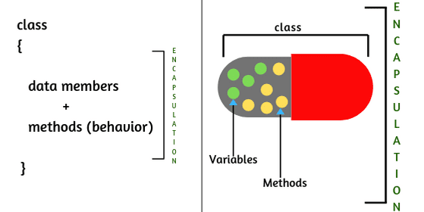
Class Member Functions (TYPES)
Setters
Getters
Mutators or Transformers
Accessors or Observers
Constructors
Destructor
Operators
Iterators

Slide 3
Member functions (Other functions)
class Point {
int x;
int y;
float calculateDistance(Point &p) const;
public:
//getters
int getX();
int getY();
Point getPoint();
//setters
void setX(int x);
void setY(int y);
void setPoint(int x, int y);
void setPoint(Point p);
//Other functions //Accessors
void printPoint() const;
Point find_closest (Point &p1, Point &p2) const;
};

Slide 4

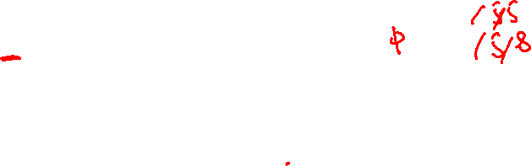
Member functions (Setters)
Used to set or update values of individual data members or complete Object
void main(){
Point p;
//Objects created but not initialized
p.setX(5);
p.setY(5);
p.setPoint(5,8);
}
X
y
?
?
How to initialize data members of objects at declaration Time

Slide 5

Member functions (Constructors)
Special Member functions
Used to Initialize data members at creation time of object
Name should be same as of class name
Have no return type
Can overload constructors by changing
Parameters type
Number of Parameters
No need to call explicitly
Automatically called by system when object is created

Slide 6
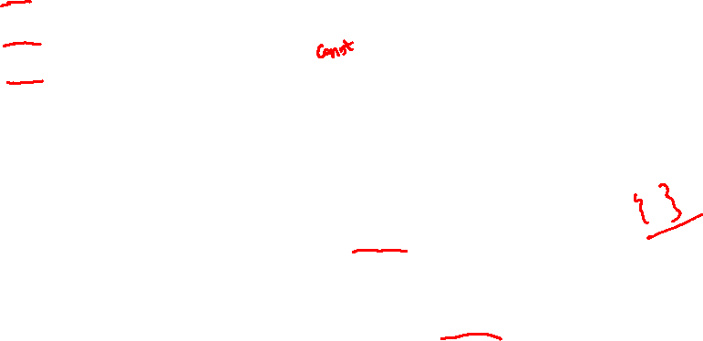
Member functions (Constructors)
Types of Constructors
Default Constructor (has no parameters)
Parameterized Constructors (have one or more parameters)
Copy Constructor (has class object by reference only)
In entire life time of the object only one constructor is called at its creation time either Default, Parameterized or Copy
If no constructor is implemented in the class
then system calls the dummy default constructor
which does nothing (does not initialize data members)
All type of Constructors should have public member access specifier

Slide 7
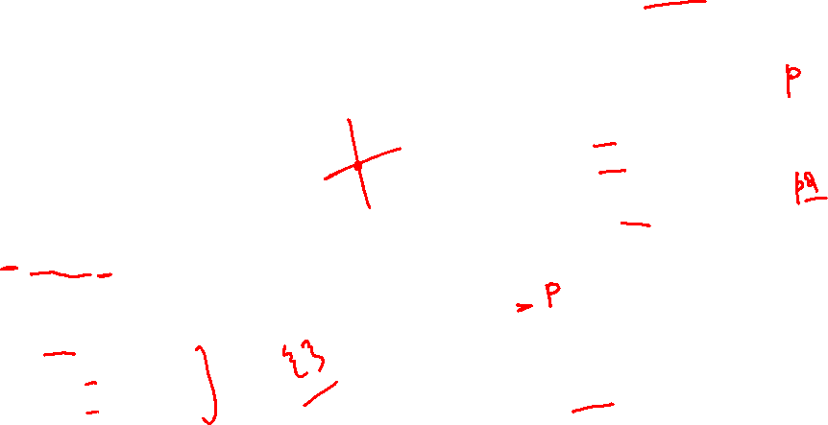
Member functions (Default Constructor)
Used to initialize objects data members with some default values
Can add only one default constructor in a class
Has no parameters
X
y
void main(){
Point p;
Point p2;
Point p3();
//Compiler Error
p.point();
// Compiler Error Cannot call more than once
p.setpoint(3,2);
//Call Setters for object further updates
}
0
0
class Point {
int x;
int y;
public:
//Default constructor
Point();
//add member functions prototype
};
Point::Point(){
x = 0;
y = 0;
}
X
y
0
0

Slide 8
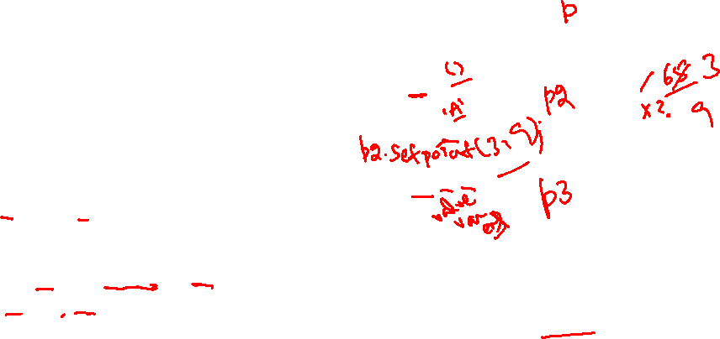
Member functions (Parameterized Constructors)
Used to initialize objects data members with input values
Can add more than one parameterized constructors in a class
X
y
0
class Point {
int x;
int y;
public:
//Default constructor
Point();
//Parameterized constructors
Point(int x);
Point(int x, int y);
};
Point::Point(){ x = 0; y = 0;}
Point::Point(int x){ this->x = x;}
Point::Point(int x, int y){
this->x = x;
this->y = y;
}
0
void main(){
Point p;
Point p2(2);
Point p3(5,8);
}
//which one to call depends on number of arguments
//C++ conversion if type not matched //Ambiguous then compile time error
X
y
2
0
X
y
5
8

Slide 9
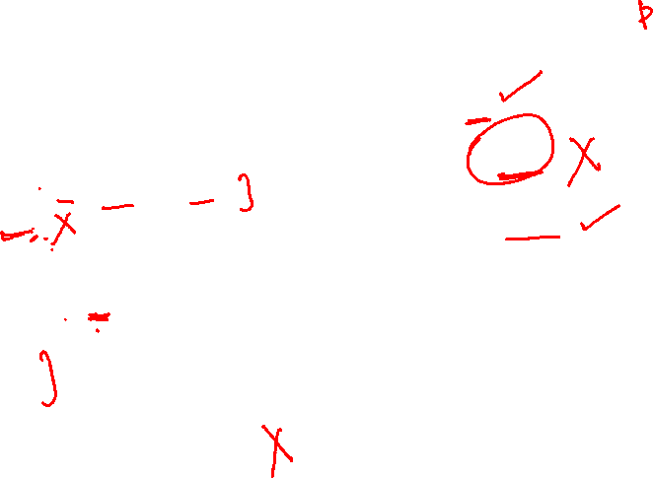
Member functions (Constructor with Default Parameters)
X
y
0
0
class Point {
int x;
int y;
public:
//Default and Parameterized
Point(int x = 0, int y = 0);
Point(int x);
};
//With Default Parameters
Point::Point(int x = 0, int y = 0)
{
this->x = x;
this->y = y;
}
Point::Point(int x){ this->x = x;}
void main(){
Point p;
Point p2(2);
Point p3(5,8);
}
//which one to call depends on number of arguments
//C++ conversion if type not matched //Ambiguous then compile time error
X
y
2
0
X
y
5
8

Slide 10
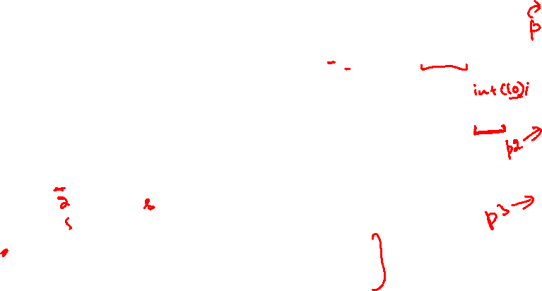
Member functions (Parameterized Constructors)
Used to initialize objects data members with input values
Can add more than one parameterized constructors in a class
X
y
class Point {
int x;
int y;
public:
//Default and Parameterized
Point(int x = 0, int y = 0);
};
//With Default Parameters
Point::Point(int x = 0, int y = 0)
{
this->x = x;
this->y = y;
}
void main(){
//Dynamic Objects
Point * p = new Point;
p->printPoint();
Point * p2 = new Point(2);
p2->printPoint();
Point * p3 = new Point(5,8);
p3->printPoint();
delete p;
delete p2;
delete p3;
}
0
0
X
y
2
0
X
y
5
8

Slide 11

Member functions (Copy Constructor)
Used to create copy of data members of different objects
Name should be same as of class name
Have no return type
Takes same class object as parameter (by constant reference only)
No need to call explicitly Automatically called by system
When an object is initialized using another object
Object is passed in a function by value
Object is returned from a function by value
If no copy constructor is implemented in the class
then system calls the built-in copy constructor
which member wise copy data using assignment operation

Slide 12
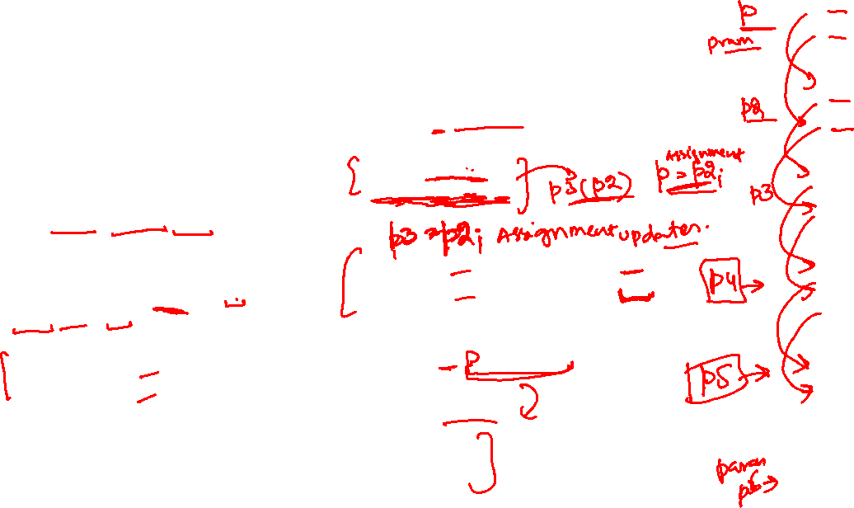
Member functions (Copy Constructor)
X
y
50
30
X
y
class Point {
int x;
int y;
public:
//Copy Constructor
Point(const Point & p);
};
//Copy Constructor
Point::Point(const Point & p)
this->x = p.x;
this->y = p.y;
}
void main(){
Point p(50,30);
//When an object is initialized using another object
Point p2(p);
Point p3 = p2;
//not assignment when object is created
Point * p4 = new Point(p3);
Point * p5 = new Point(*p4);
//not called for anonymous objects
Point p6(point(3,4));
//Changed to
Point p6(3,4);
delete p4;
delete p5;
}
50
30
X
y
50
30
X
y
50
30
X
y
50
30
X
y
3
4

Slide 13
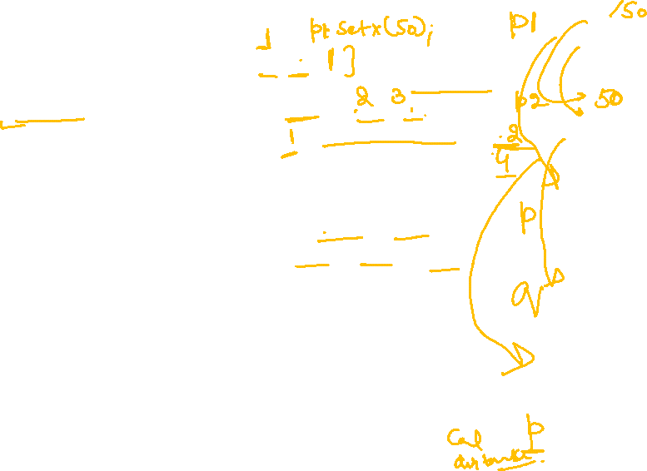
Member functions (Copy Constructor)
X
y
class Point {
int x;
int y;
public:
float calculateDistance(Point p)
const;
//Copy Constructor
Point(const Point & p);
};
//Copy Constructor
Point::Point(const Point & p)
this->x = p.x;
this->y = p.y;
}
void main(){
Point p;
Point p2(p);
//Object is passed in function by value
cout << equal (p1, p2);
cout << p.calculateDistance(p3);
}
//objects pass by value or copy
bool equal(Point p, Point q){
if((p.x == q.x)&&(p.y == q.y))
return true;
else
return false;
}
0
0
X
y
0
0
X
y
0
0
X
y
0
0
X
y
0
0

Slide 14
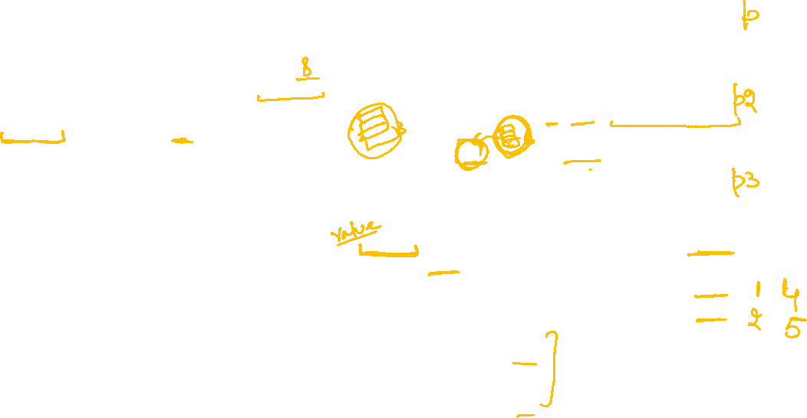
Member functions (Copy Constructor)
X
y
class Point {
int x;
int y;
public:
float calculateDistance(Point p) const;
Point find_closest(Point &p1,
Point &p2) const;
//Copy Constructor
Point(const Point & p);
};
//Copy Constructor
Point::Point(const Point & p)
this->x = p.x;
this->y = p.y;
}
void main(){
Point p(3,4);
Point p2(p);
Point p3(3,8);
//Object is returned from function by value
p.find_closest(p2,p3).printPoint();
Point p4 = p.find_closest(p2,p3);
//not called for anonymous objects
}
Point Point:: find_closest(Point &p1, Point &p2)const{
float d1 = calculateDistance(p1);
float d2 = calculateDistance(p2);
if(d1<=d2)
return p1;
else
return p2;
}
3
4
X
y
3
4
X
y
3
8

Slide 15

Member functions (Destructor)
Special Member functions
Used to deallocate data members memory at destruction time of object
Name should be same as of class name prefix with telda (~)
Takes no parameters
Has no return type
Cannot overload destructors
No need to call explicitly automatically called by system when
Object is out of scope
Dynamic object is deallocated
Destructor should have public member access specifier always
If no destructor is implemented in the class
then system calls the dummy default destructor which does nothing

Slide 16
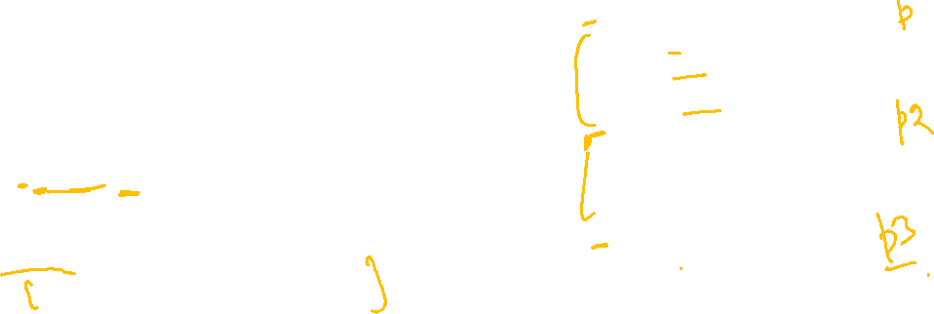
Member functions (Destructor)
Can add only one destructor in a class
class Point {
int x;
int y;
public:
//Constructors
Point(int x = 0, int y = 0);
Point(const Point & p);
//Destructor
~Point();
};
Point::~Point(){
cout << "Nothing to do";
}
void main(){
{
Point p;
Point p2(2);
Point p3(5,8);
}
//Destructor called
//Destructor called
//Destructor called
cout << "out of block";
}
X
y
0
0
X
y
2
0
X
y
5
8

Slide 17
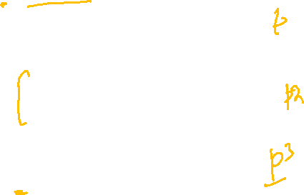
Member functions (Destructor)
Can add only one destructor in a class
class Point {
int x;
int y;
public:
//Constructors
Point(int x = 0, int y = 0);
Point(const Point & p);
//Destructor
~Point();
};
Point::~Point(){
cout << "Nothing to do";
}
void main(){
fun();
}
void fun(){
Point p;
Point p2(2);
Point p3(5,8);
//Destructor called
//Destructor called
//Destructor called
}
X
y
0
0
X
y
2
0
X
y
5
8

Slide 18
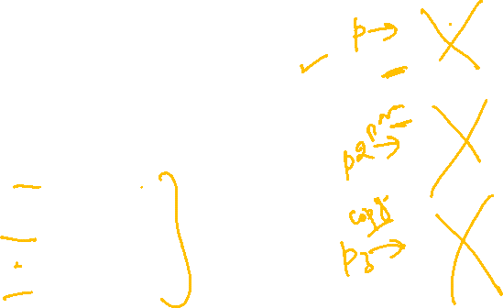
Member functions (Destructor)
Can add only one destructor in a class
class Point {
int x;
int y;
public:
//Constructors
Point(int x = 0, int y = 0);
Point(const Point & p);
//Destructor
~Point();
};
Point::~Point(){
cout << "Nothing to do";
}
void main(){
//Dynamic Objects
Point * p = new Point;
Point * p2 = new Point(2,8);
Point * p3 = new Point(p2);
delete p;
//Destructor called
delete p2;
//Destructor called
delete p3;
//Destructor called
}
X
y
0
0
X
y
2
8
X
y
2
8

